Slide 1
Project R
Team 13

Slide 2
Team Members and Roles
Min Dye
Scott Hargrove
Ryan Do
Peter Wainwright
Project Director
Assistant Graphics Designer
Assistant Developer
Vice-Project Director
Lead Developer
Lead Graphics Designer
Animation Designer
Project Planner
Application Developer

Slide 3

Introduction/Scope
Play the newest 2D Action Platformer: Project R
Make your way through unique enemies and traps!
Powerful boss monsters will stop you on the way...
Unlock better weapons as you advance through stages
Death will be costly as you will have to start over from the beginning

Slide 4
Original Scope vs. Final Product
Original Scope | Final Product
5 Playable Stages | 3 Playable Stages
UI has HP bar and inventory | UI has HP bar and mana bar
Currency for upgrading weapons | New weapons unlock after bosses
Random chest drops new weapons | New weapons unlock after bosses
Story about evil magician | No story/dialogue
Enemies get stronger progressively | Enemies’ stats are constant
Notes:
Originally intended features vs. what we have now
These are the most notable ones from documented items in the original scope.
Some items may have been omitted for their lack of importance and concision of the powerpoint.

Slide 5
New Features and Discarded Plans
New Features
Dash & down movements | Two boss monsters
Healing object | Knockback system
InputManager (custom inputs) | Invincible frames
Discarded Plans
NPC’s | Tutorial
Game over screen | New Enemies and Graphics
Notes:
These are talking about new/removed things during development.
New features are the features that were not expected from the beginning of the project but added on as the project developed
Discarded plans are the features that we wanted to create (not from original scope) but did not get finished due to time constraint or technical reasons.
These do not relate to original scope.

Slide 6
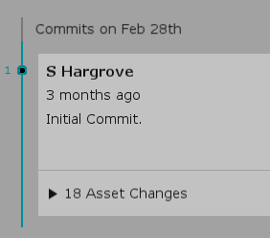
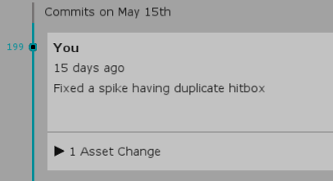
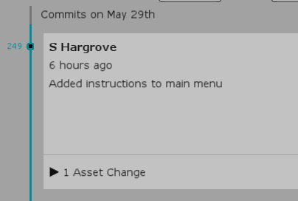
Account of Work
About 250 revisions have been made between February 28th and May 29th
If a revision took 20 minutes on average and testing took another 20 minutes...
250 revisions is approximately 167 hours!
Fun Fact: total of 2161 lines of code have been written in 35 files

Slide 7
Account of Work
Out of more than 50 prototype in-house graphics, 5 were adopted
If a graphic took 30 minutes on average, this is approximately 25 hours
Since February 27th, 2745 messages were sent on our Discord
Averaging to about 30 messages per day
Messages sent on GroupMe are not accounted
62 files have been submitted on Bitbucket for weekly labs
If a file took 1 hour on average, this is approximately 62 hours
Total Hours: 254 hours + 144 hours in lab + unaccountable hours on research
= 398 hours + α
Notes:
Hours in lab = 18 labs * 2 hours * 4 team members = 144 hrs
Hours spent watching tutorials, looking up syntax, and researching codes, etc. cannot be calculated, which is the + α

Slide 8
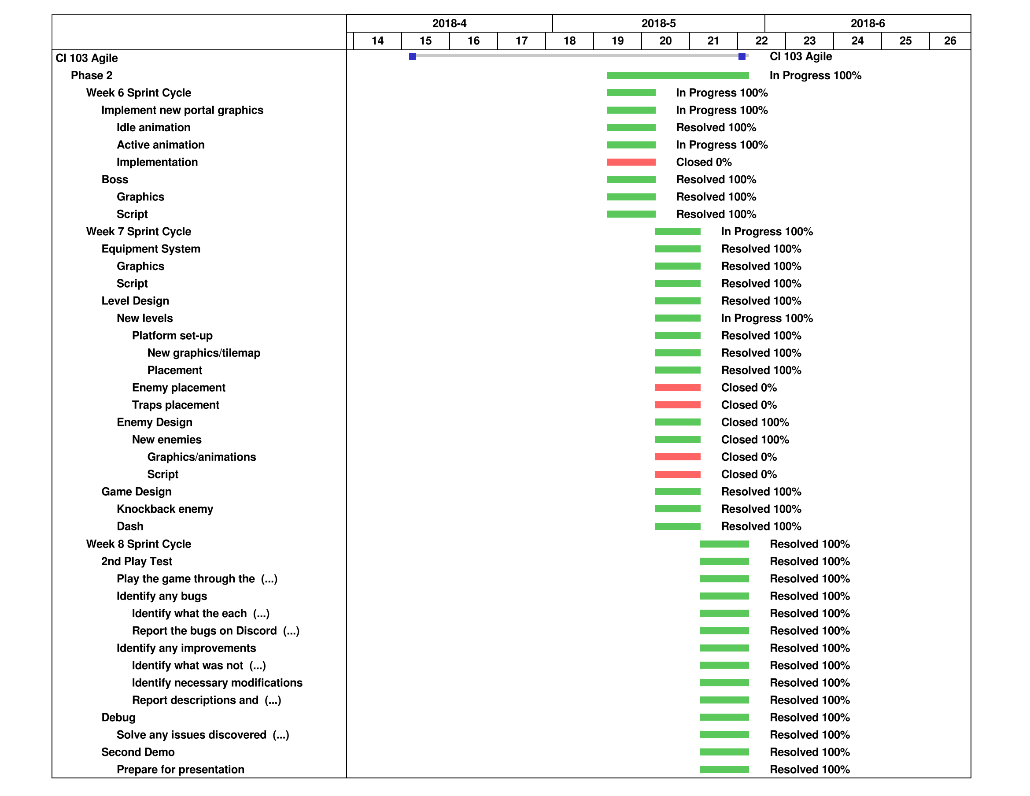
Gantt Chart
Notes:
Closed tasks are discarded tasks

Slide 9
What We Learned
Technical Skills
Utilizing Unity engine
Learning how to code in C#
Scenes, prefabs, canvas, objects, physics, etc.
Troubleshooting
Utilizing various drawing softwares
Sprite editing and animating
Design / Management Skills
Identifying scope, requirements, systems, etc.
Documentation, Gantt and Burnout charts
Time management
Effective communication between members

Slide 10
Demo

Slide 11
Q&A

